Slide 1


BUILDING THE JT-HARMONY MOBILE MUSIC APPLICATION WITH INTEGRATED RECOMMENDATION AND SHARING
Phan Thi Huynh Thu - Le Vo Duy Tuan
Supervisor: Msc. Nguyen Thi Hong Luong

Slide 2









Content
01
02
03
04
05
Introduction
Theoretical Foundation
Analysis and Design
Implementation
Conclusion & Future Development

Slide 3


Introduction
JT - Harmony

Slide 4

Reason for choosing the topic
Market Context
Current Problems
The Vietnamese digital music market is growing at 25% per year.
Market Gap: There is a lack of applications that effectively combine AI + Social + Creative elements.
50 Million potential users
Solution
Young people are shifting towards a "Listen while Creating" trend.
Create a platform that connects listeners and creators with the support of AI technology.
I. Introduction

Slide 5

Features
Core Features
Music Streaming: Search and listen to music.
Playlist Management: Create, share, public/private playlists.
User Management: Register/Login, Personal Profile.
Social Features: Chat, Follow, Upload Covers/Original Songs.
Advanced Features
AI Recommendations: Suggest music based on history, mood, activity, time, and preferences.
I. Introduction

Slide 6










Technologies
I. Introduction

Slide 7






II. Theoretical Foundation
01
Demand
02
Problem
Challenges and Opportunities
03
Solution
04

Slide 8
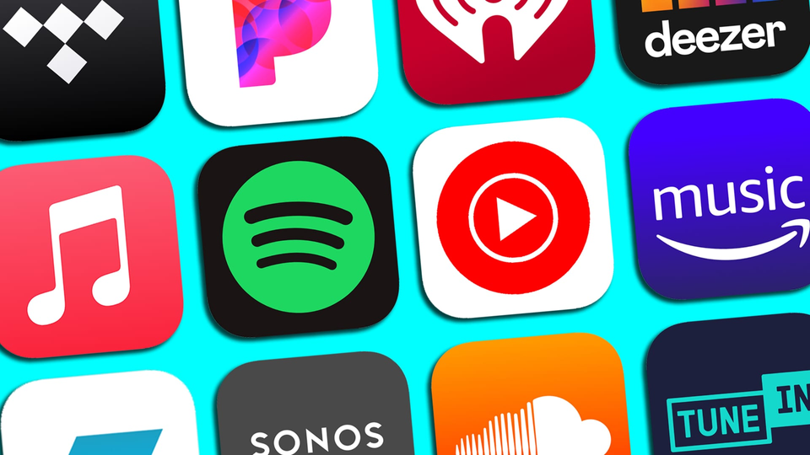
1. Demand
Discover music based on personal preferences.
Share and connect with the community.
Need to express talent (Covers/Composing).
Access high-quality Vietnamese music.
2. Problem
Spotify: High cost, lacks social and creative features.
ZingMP3/Nhaccuatui: Outdated technology, unoptimized user experience.
TikTok/YouTube: Focused on video, not optimized for audio-only listening.
II. Theoretical Foundation

Slide 9





3. Solution
Smart Music Recommendation (Gemini AI).
Integration of music streaming & social networking.
4. Challenges and Opportunitiesi
Competition: Tech giants (Spotify, YouTube).
Copyright: Licensing costs & legal issues.
User Acquisition: Marketing costs.
Growing Market: 50 million users.
Technology Readiness: AI/ML, Cloud, Mobile App readiness.
II. Theoretical Foundation

Slide 10
Analysis and design
JT - Harmony

Slide 11
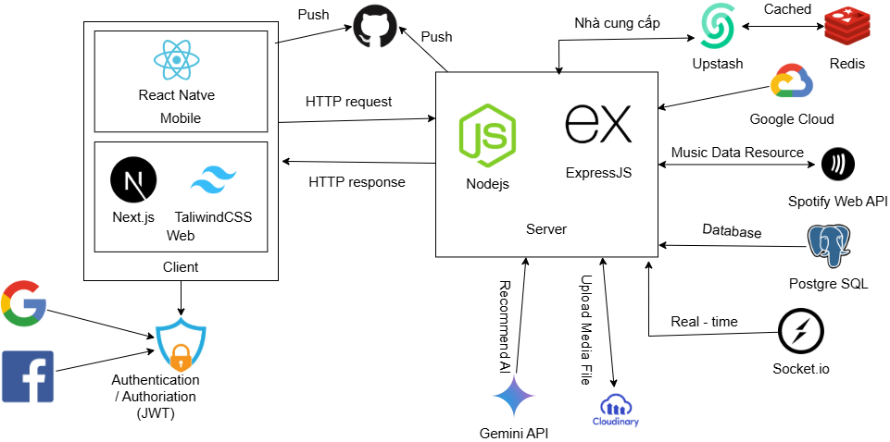
System Architecture
III. Analysis and design

Slide 12
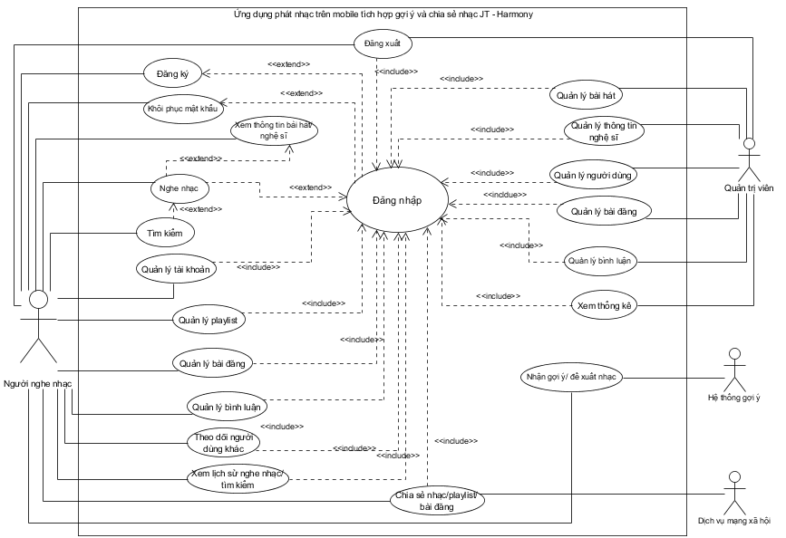
Use Case Diagram

Slide 13
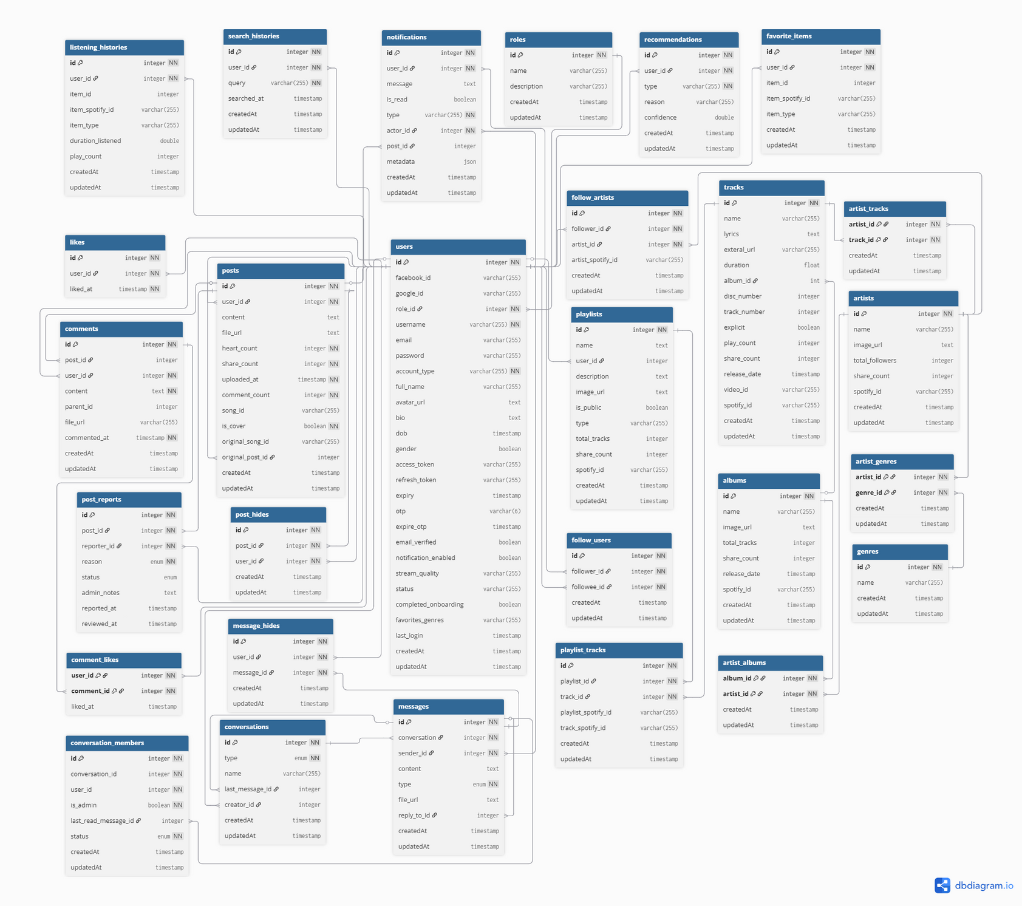
ERD Diagram

Slide 14
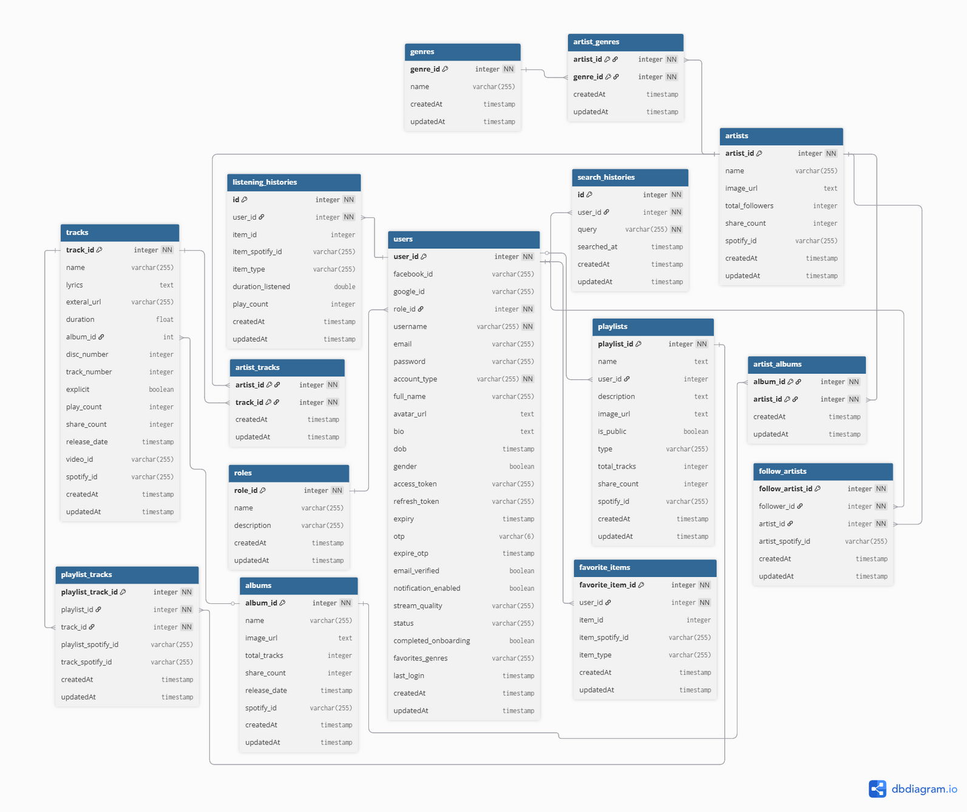
ERD Diagram
(Music)

Slide 15
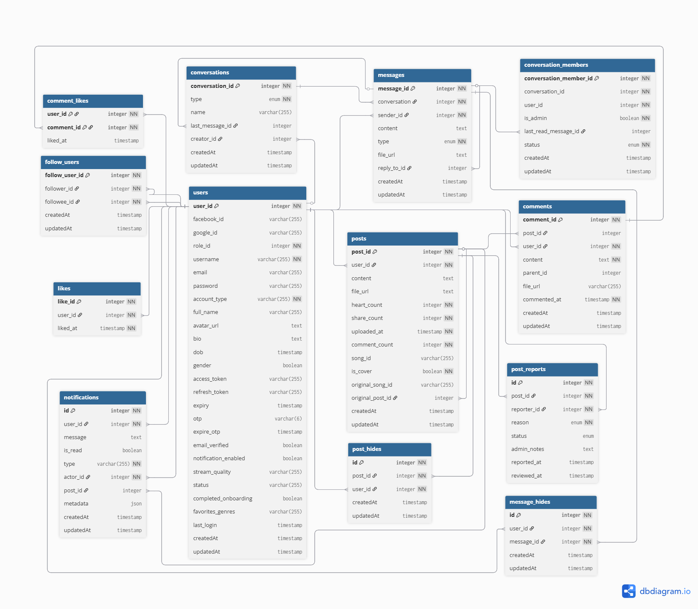
ERD Diagram
(Social)

Slide 16
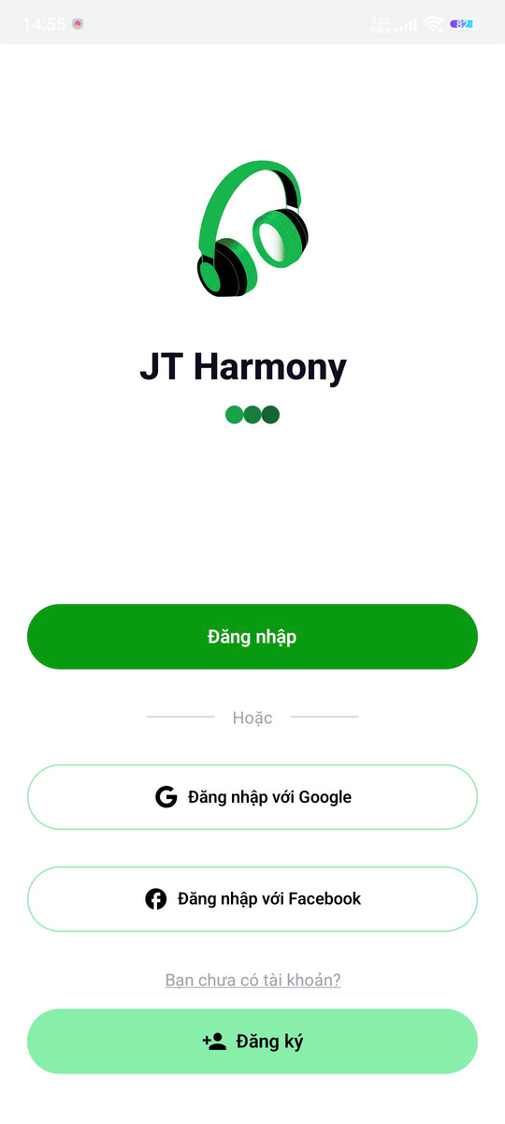
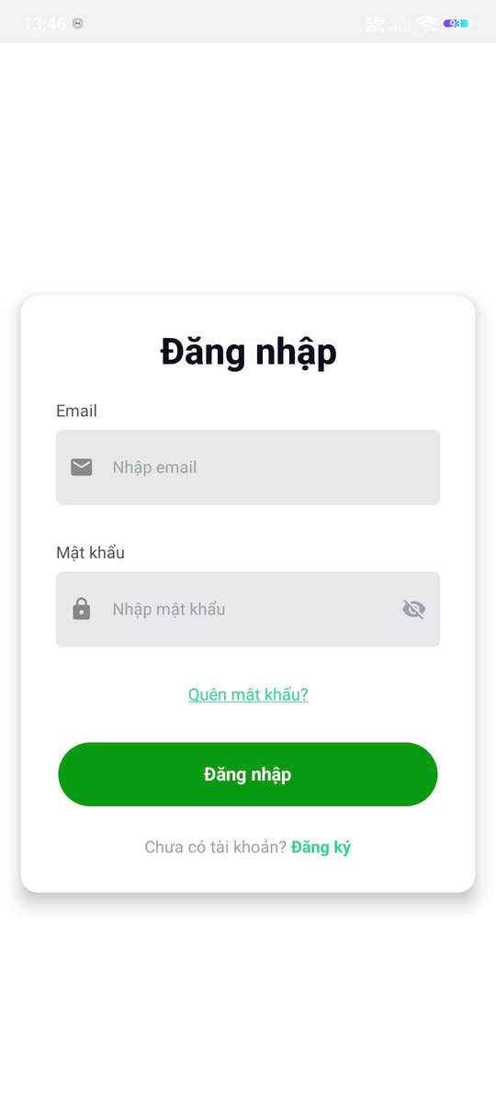
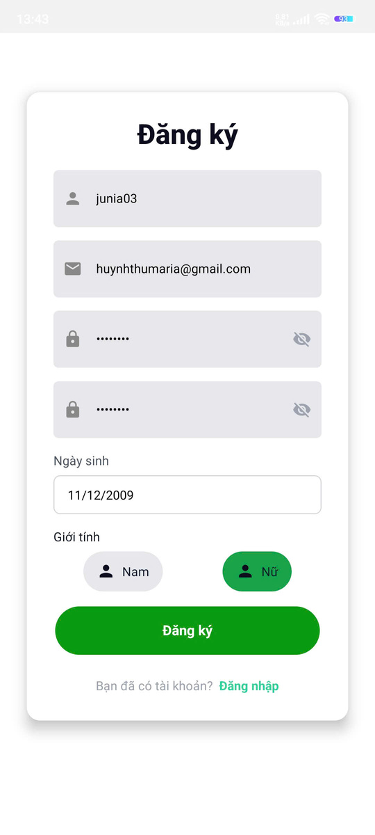
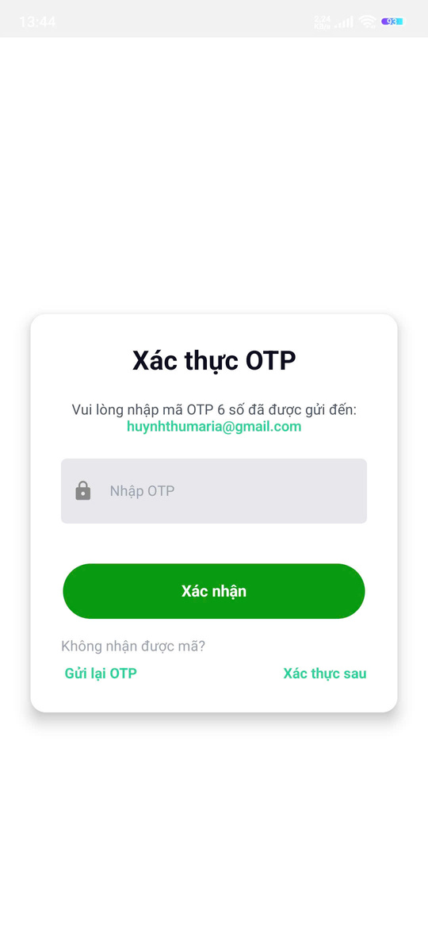

III. Analysis and design
Login/Logout Screen

Slide 17
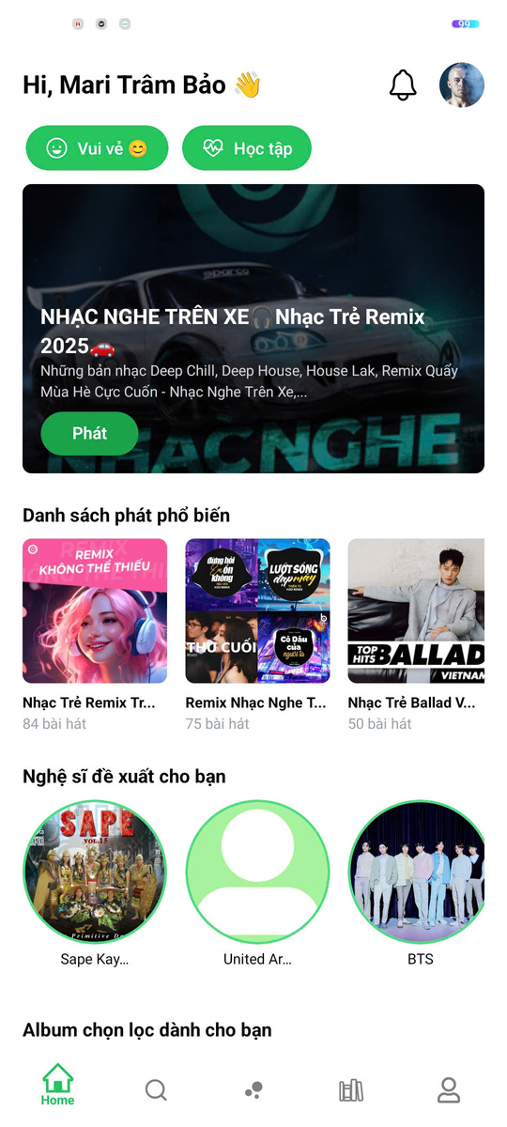
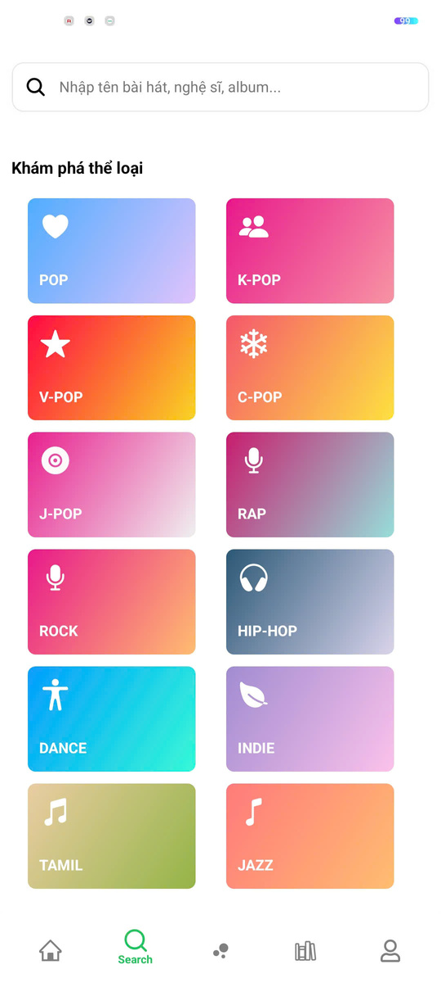
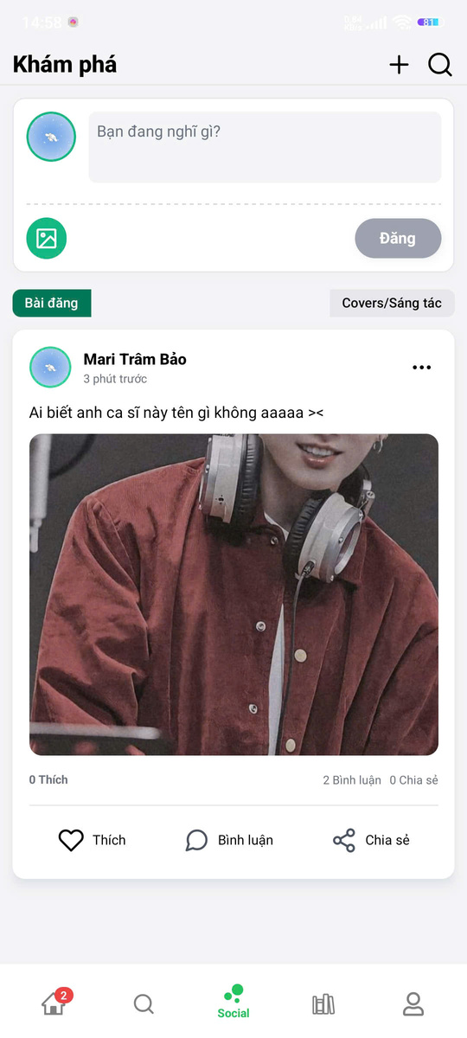
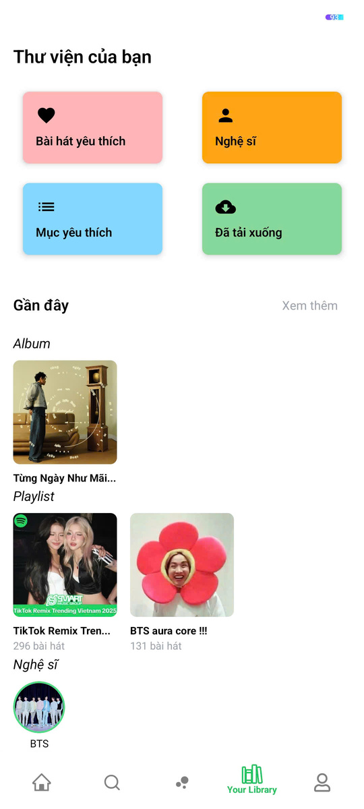
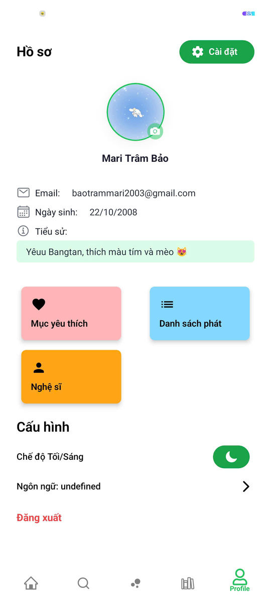
III. Analysis and design
Main screens

Slide 18
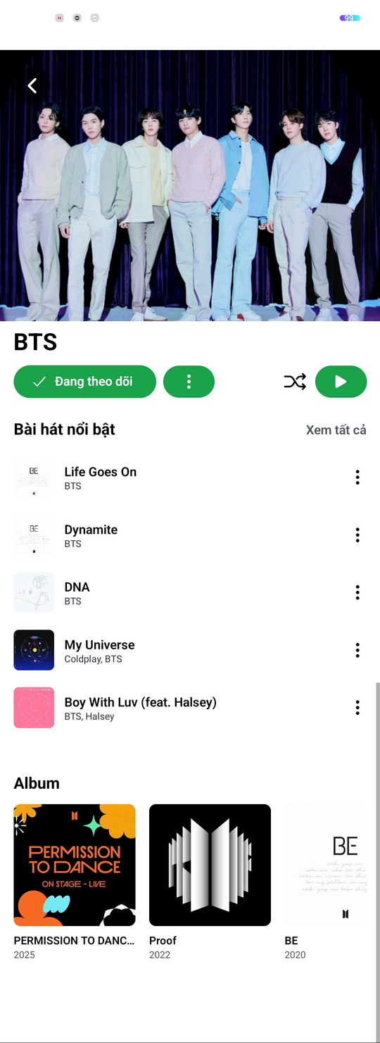
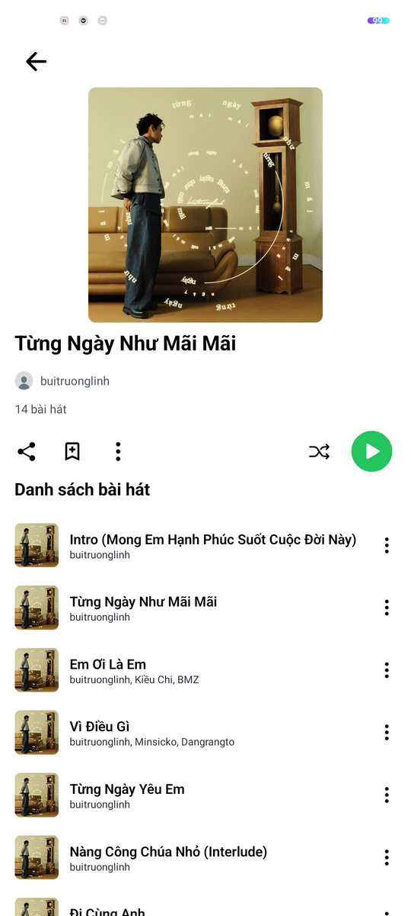
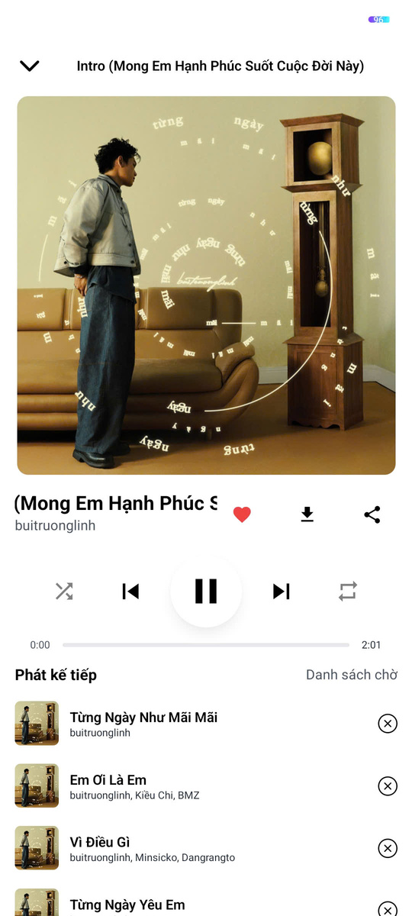
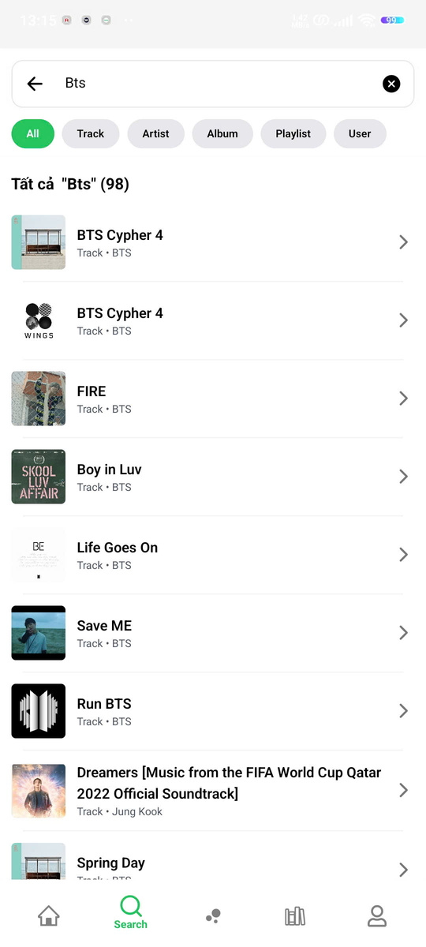
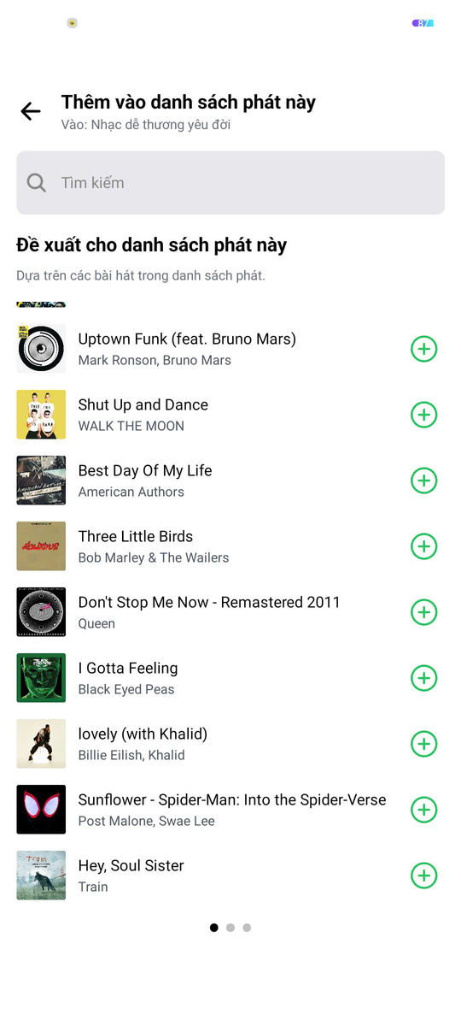
III. Analysis and design
Functional screens

Slide 19
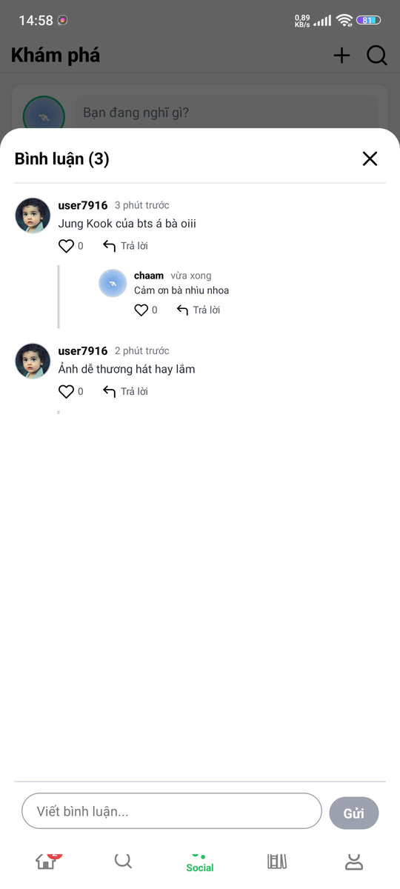
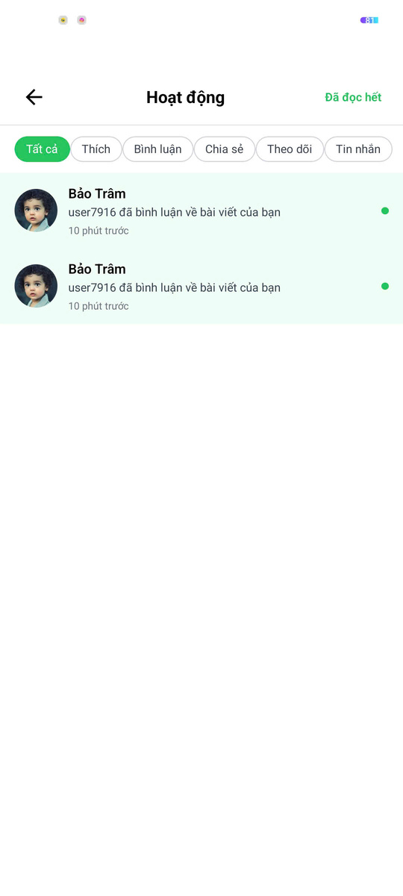
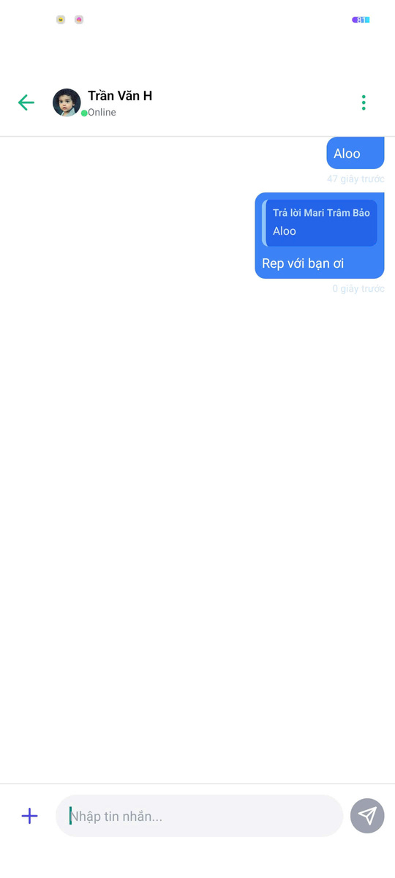
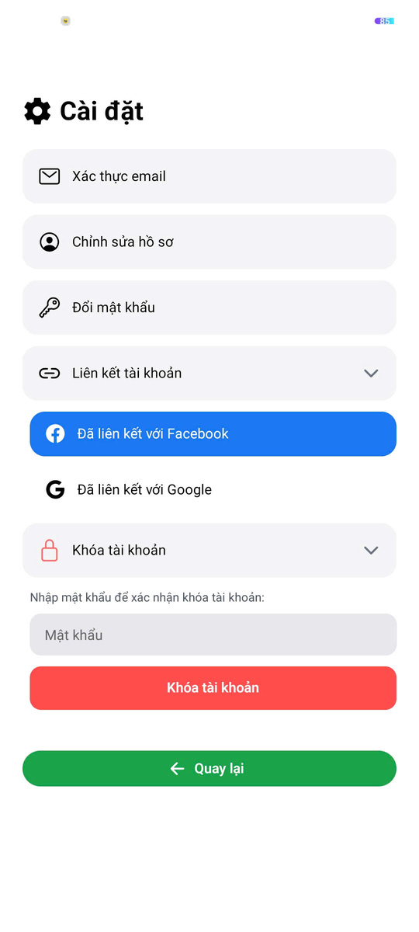
III. Analysis and design
Functional screens

Slide 20
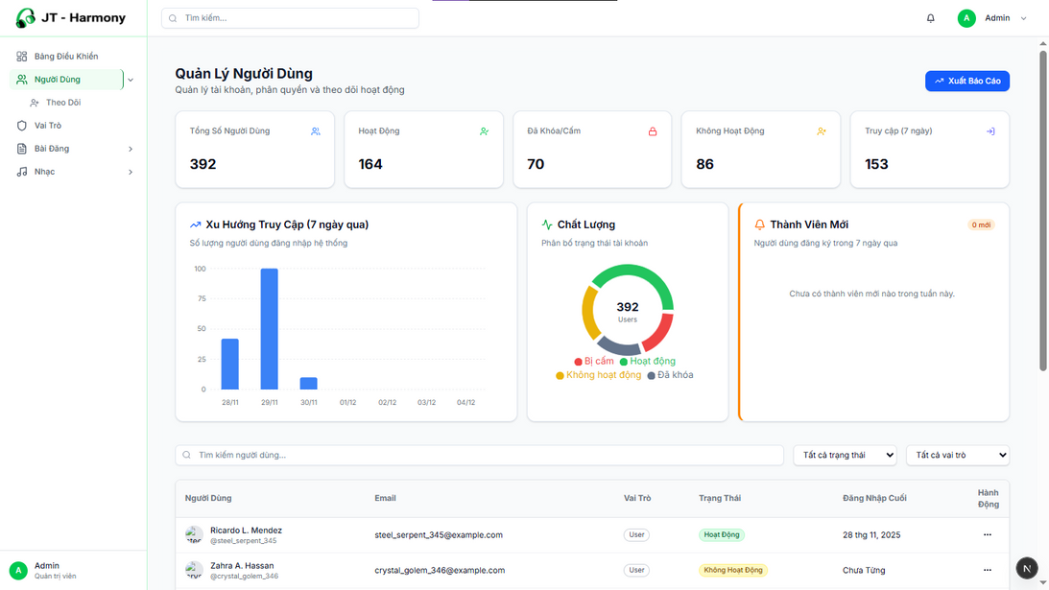
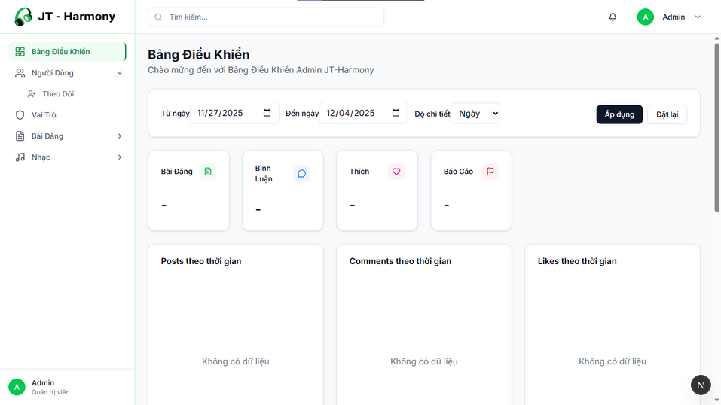
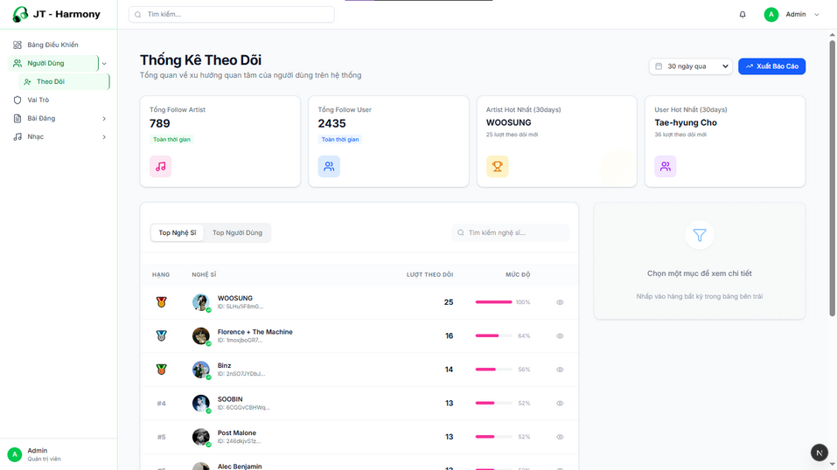
User management page
Home
Tracking information management page
III. Analysis and design
Administrator's management page

Slide 21
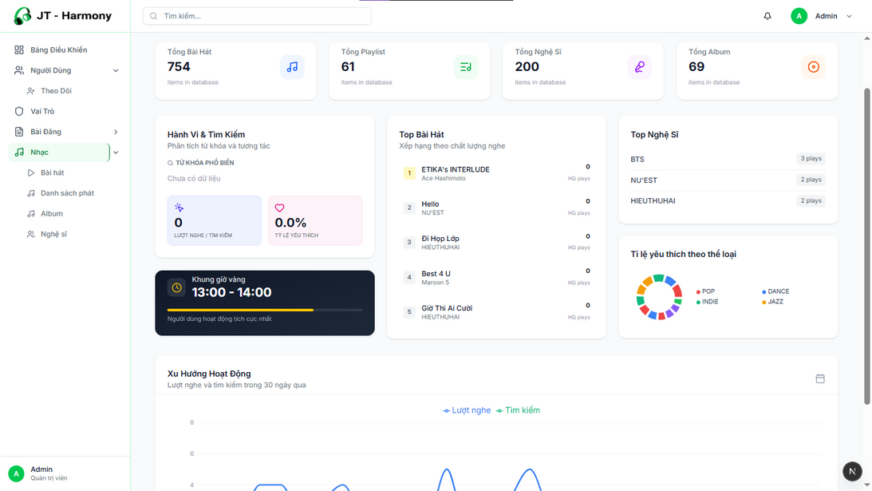
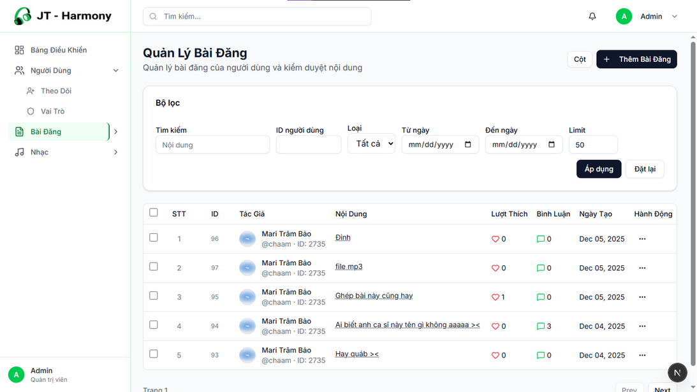
Detailed post information statistics
Music information statistics viewing page
III. Analysis and design
Administrator's management page

Slide 22
Conclusion & Future Development
JT - Harmony

Slide 23

Conclusion - Achievements
Successfully built the complete JT-Harmony system, including the Mobile App for clients, Admin Dashboard, and Server system.
Effectively met user needs for searching, online streaming, and creating personal playlists.
Successfully implemented Real-time interaction features such as Chat, Comments, Cover uploads, and Instant Notifications using Socket.IO technology.
Successfully integrated the recommendation model using Gemini AI, personalizing the music listening experience for users.

Slide 24
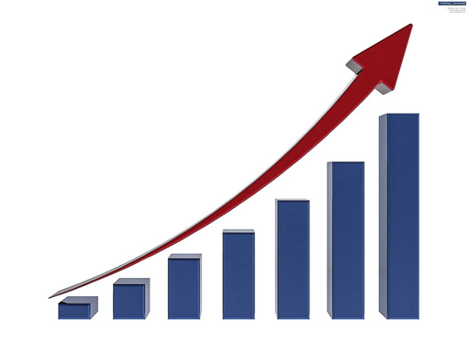
Conclusion - Limitations
Copyright Issues
Data Dependency
Missing Offline feature
Future Development
AI Upgrade: Retrain the recommendation model with a larger dataset (Big Data) to improve accuracy.
Security: Enhance security layers to better protect user data.
UI/UX Optimization: Optimize the user interface to enhance the user experience.
Multi-language Support

Slide 25

Thanks for watching
JT - Harmony

